Slide 1
REMOTE LAB SYSTEM
Base Station
Designed by:
Gregory Asher - Project Manager, Enclosure
Andrew Soshea - Hardware
Gytautas Jankauskas - Software
Paolo Sebastian - Software
Dr. Arnold Berger - Faculty and Industrial Advisor
Notes:
https://1drv.ms/p/s!All5tQkJQWpib6hwnpGKgt0RSe0

Slide 2
Presentation structure
Project background
Project overview
Hardware design
Software design
Project management

Slide 3
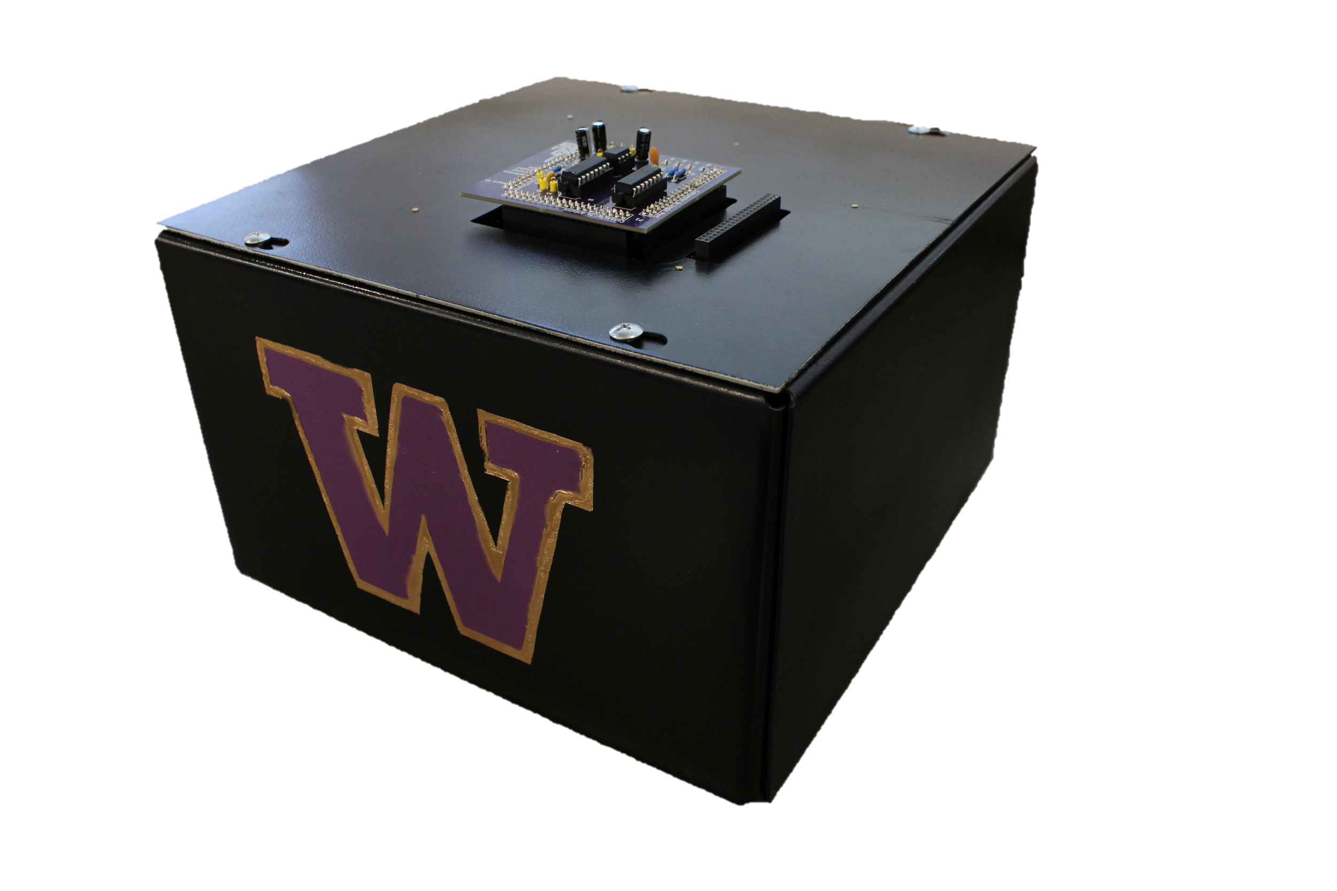
Project Background
Previous Designs
Distance learning tool
Study aid

Slide 4
Why is this project necessary?
Commuter campus
Limited access to lab resources
Students have
More time for labs
Unlimited hours
Access to required lab equipment

Slide 5
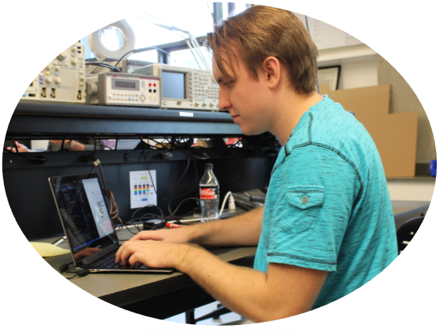
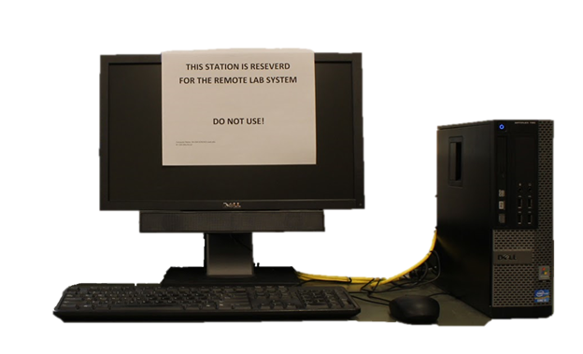
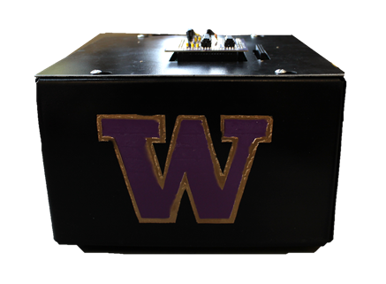
How does it work?
Student’s Personal Computer
Remote Desktop Connection
Campus Workstation
Experimental Daughterboard
Remote Lab System
Notes:
The solution, our remote lab system. Students can connect anytime, from anywhere, at their convenience and work on lab experiments.
The remote lab system is plugged into a campus workstation that students connect to using a remote desktop application. Once connected to the campus workstation the student opens the designed graphical user interface and may begin running experiments on an attached experimental daughter board designed by other capstone teams.
Experiments can range in complexity from simple RC circuits, to microprocessor systems.
Transition to Andrew to talk about the hardware design

Slide 6
Hardware Design

Slide 7
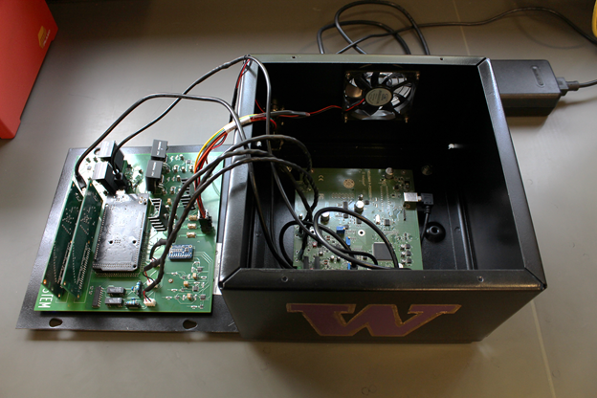
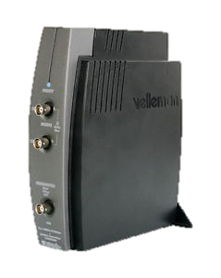
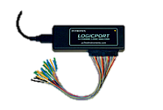
Remote Lab System Hardware Overview
Velleman Oscilloscope and Function Generator
Two 34-channel Intronix Logic Analyzers
Arduino Mega 2560
60 Watt Power Supply
Motherboard
Notes:
The remote lab system contains a Velleman Oscilloscope and Function Generator powered solely from USB connection. This inexpensive and easy to use piece of hardware provides tremendous support to experimental boards.
The system is also equipped with 2 logic analyzers allowing experimental daughter boards to observe microprocessor function
We also have a 16-bit analog to digital converter allowing students to take real time node voltage measurements with precision.
Controlling all of the various components on the motherboard is an Arduino Mega.
All of these devices are mounted to the motherboard we designed.
Andrew will now explain the detailed components of the motherboard itself.

Slide 8
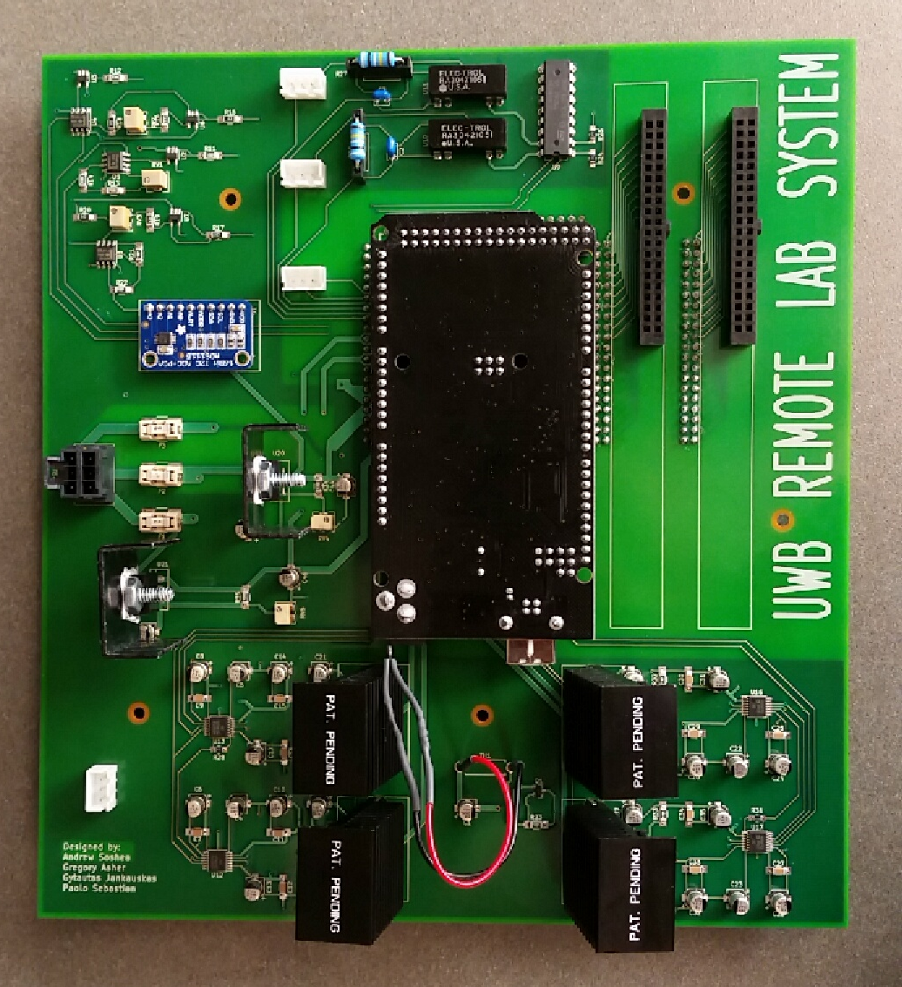
Motherboard Overview
Connects external systems with subcircuits
Main circuit elements
Regulated Voltage Rails
Variable Voltage Supplies
Analog-to-Digital Converter (ADC)
Temperature Controlled Fan

Slide 9
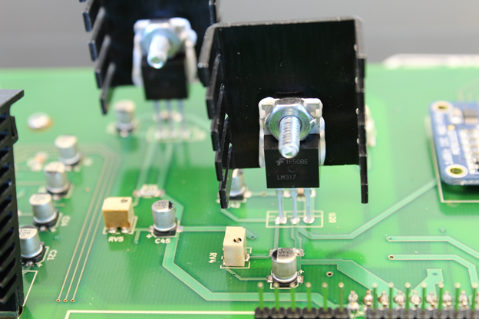
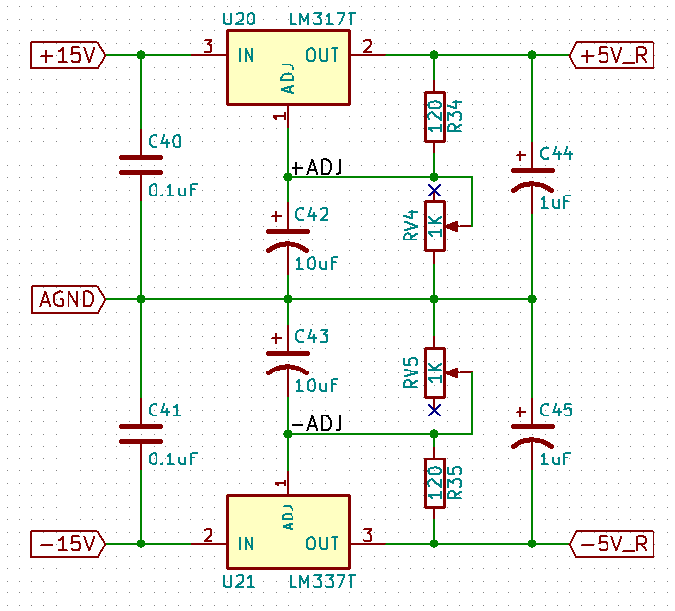
Fixed +/- 5 Volt Regulated Rails
Regulate +15 V supply to +5V
Regulate -15 V supply to -5V
Used by motherboard and daughterboards

Slide 10
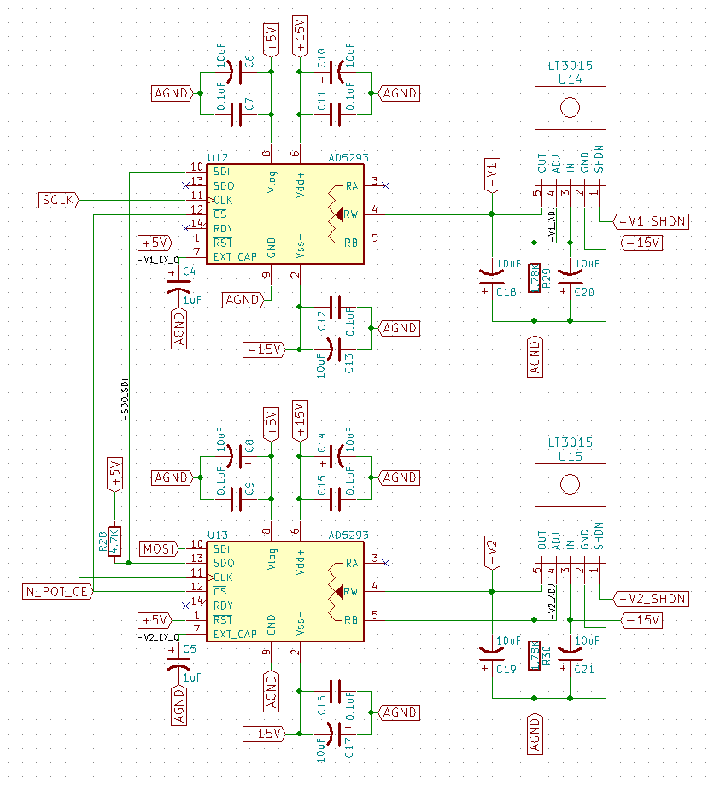
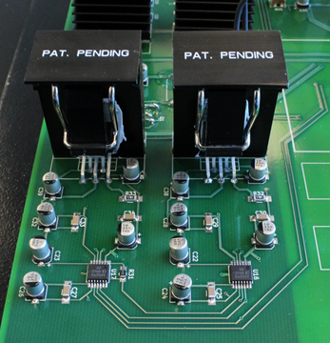
Digitally Controlled Variable Regulators
Four independent adjustable DC voltages
Adjustable voltage ranges:
1.25 to 15.00 V
-1.25 to -15.00 V
Supplied directly to daughterboards
Controlled by digital potentiometers

Slide 11
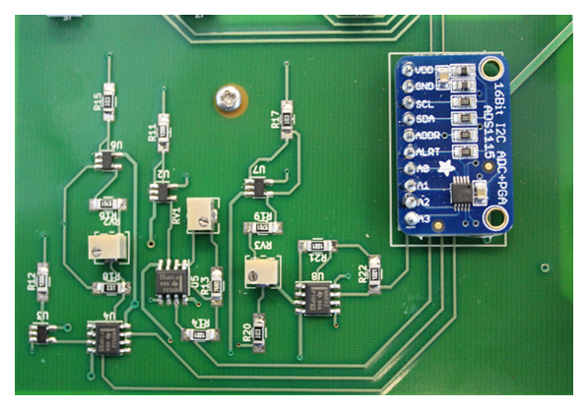
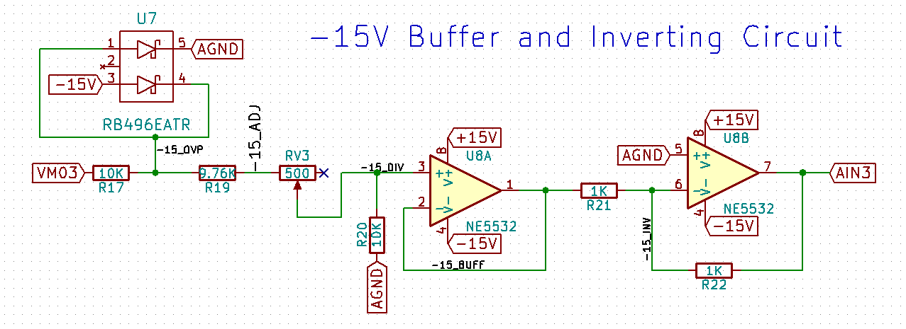
16-Bit Analog to Digital Converter
Converts analog signals from daughterboards to digital.
Up to 16-bit resolution per input
16 Bit: 0.000076294 V/bit (76.294 μV/bit)
8 Bit: 0.01953 V/bit (19.53 mV/bit)
Four single-ended inputs
Over/under Voltage protection
Buffered and down-scaled inputs
Notes:
versus 0.01953 V/bit (19.53 mV/bit) for 8 bit

Slide 12
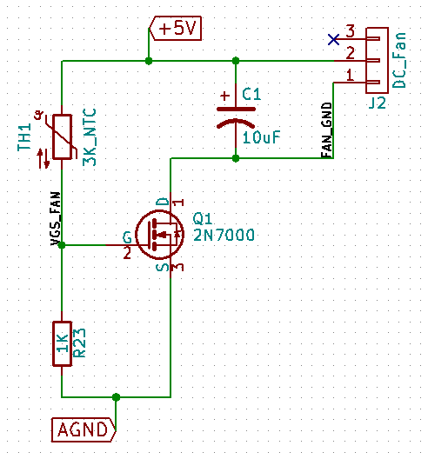
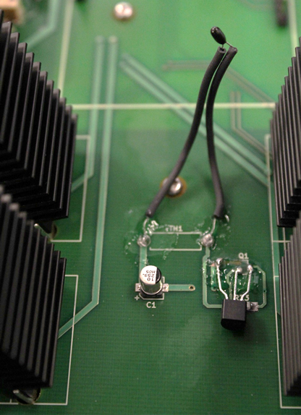
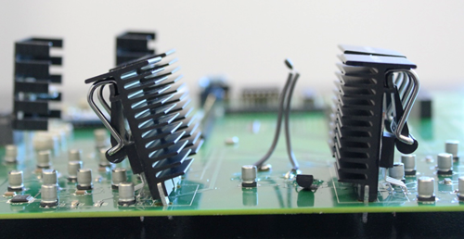
Thermal Regulation
High-dissipation heatsinks
Thermistor and FET provide proportional voltage control
Temperature increase causes more airflow
Direction of Air -flow

Slide 13
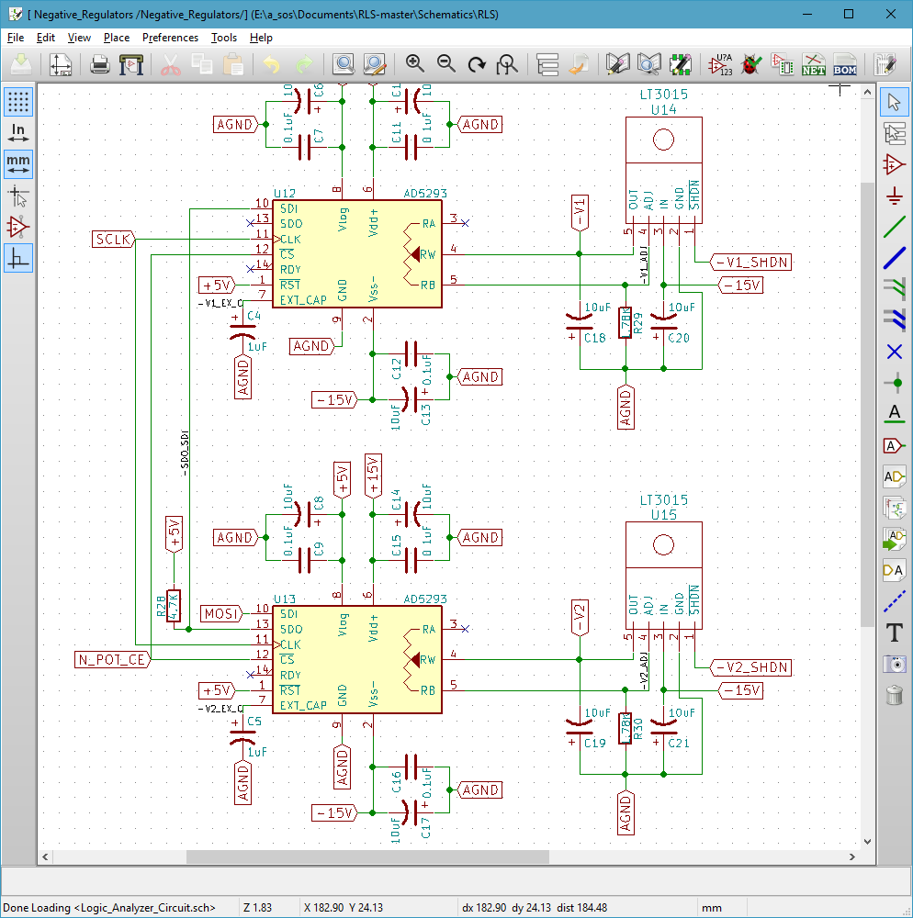
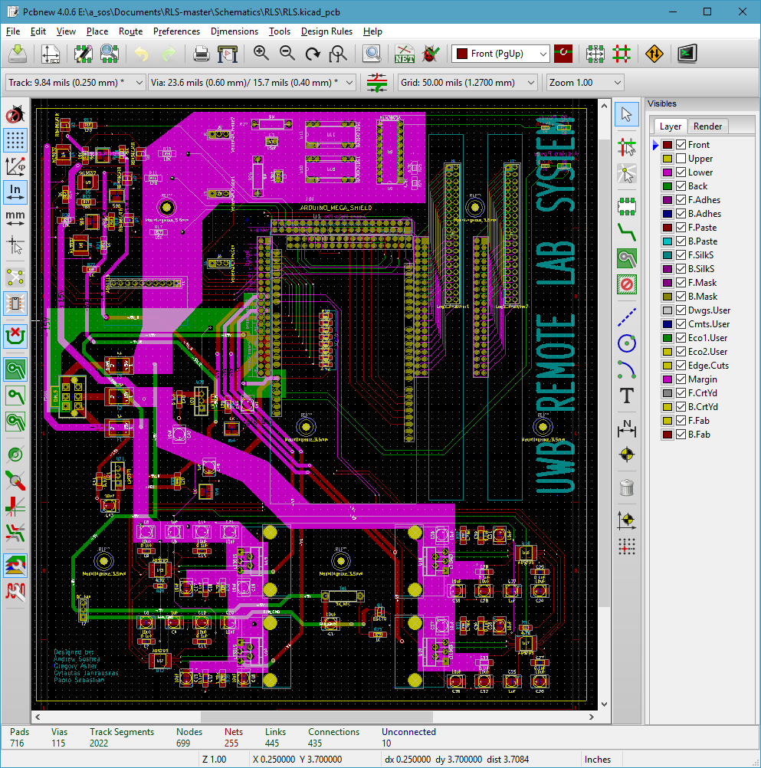
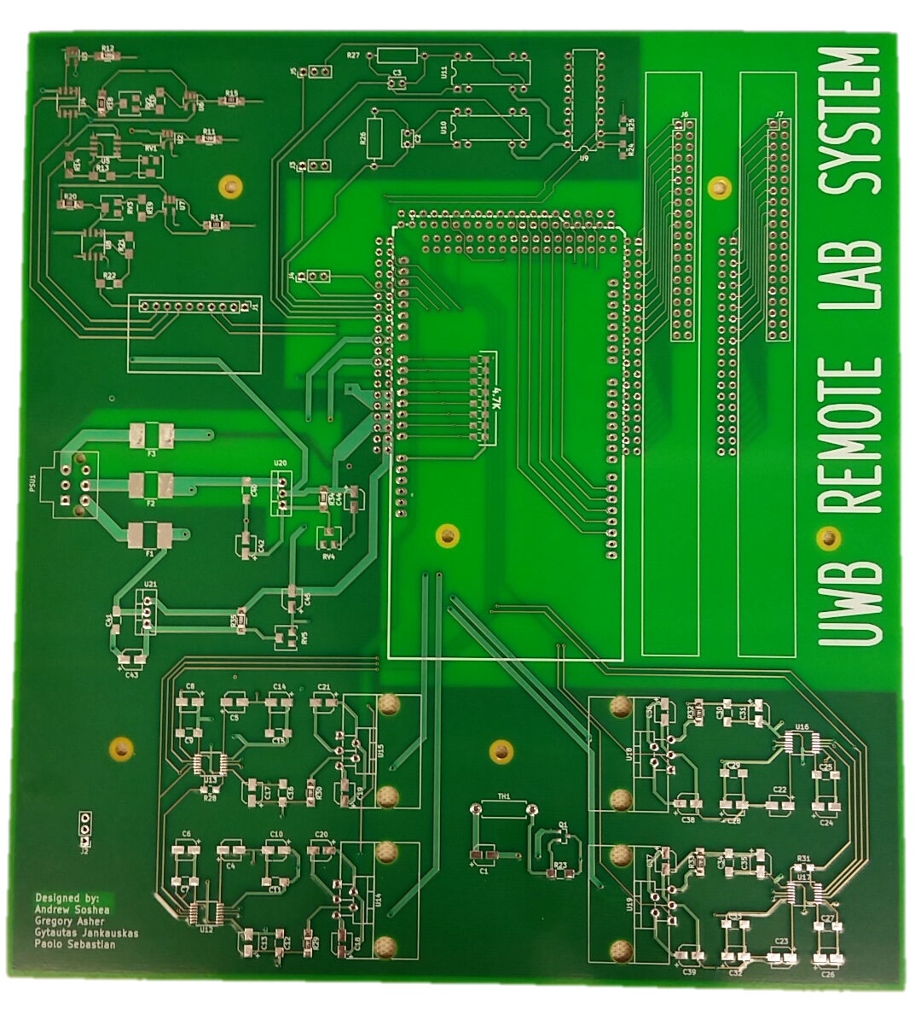
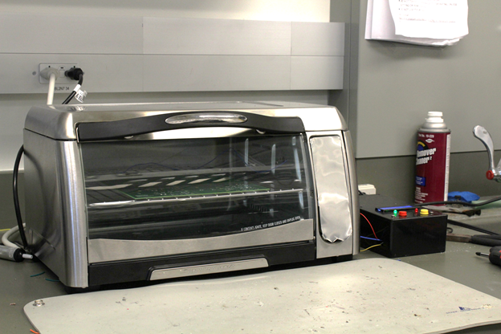
Board Construction
Used KiCAD for schematic and PCB layout
PCB created by Prototron Circuits in Redmond
Soldered SMT components with reflow oven
Soldered over 300+ thru-holes by hand

Slide 14
Software Design

Slide 15
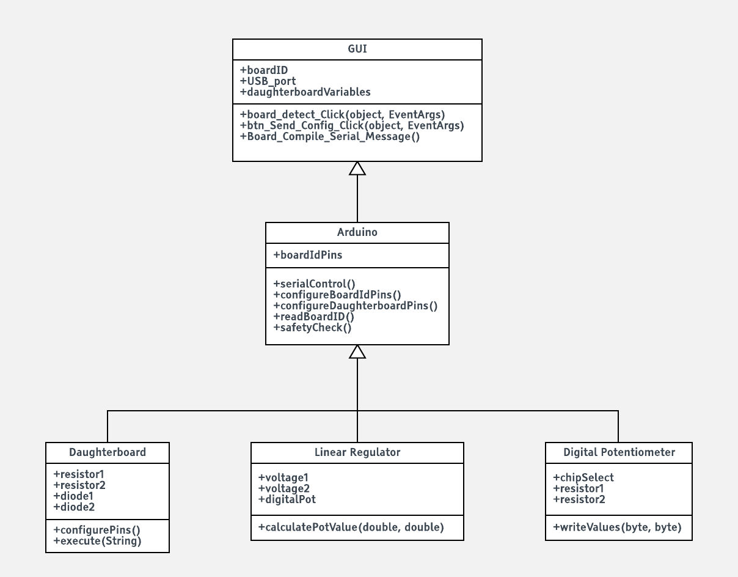
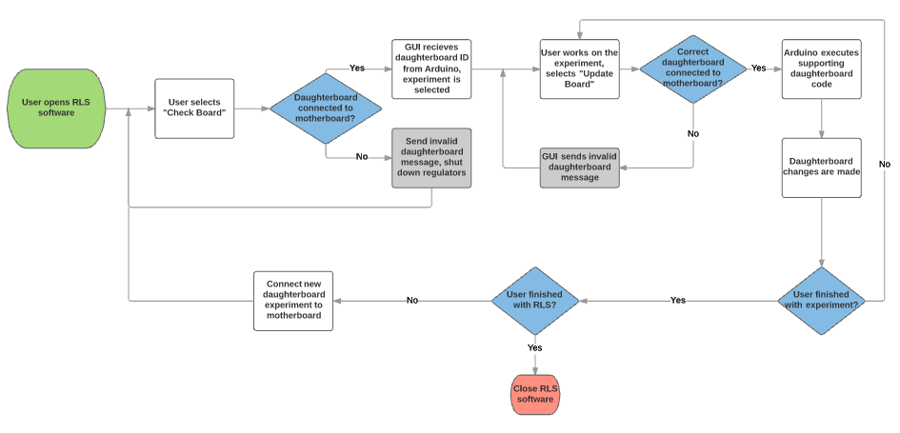
Remote Lab System Software Overview
Arduino
Daughterboard control
Linear regulator control
Digital potentiometer control
Graphical User Interface (GUI)
Daughterboard

Slide 16
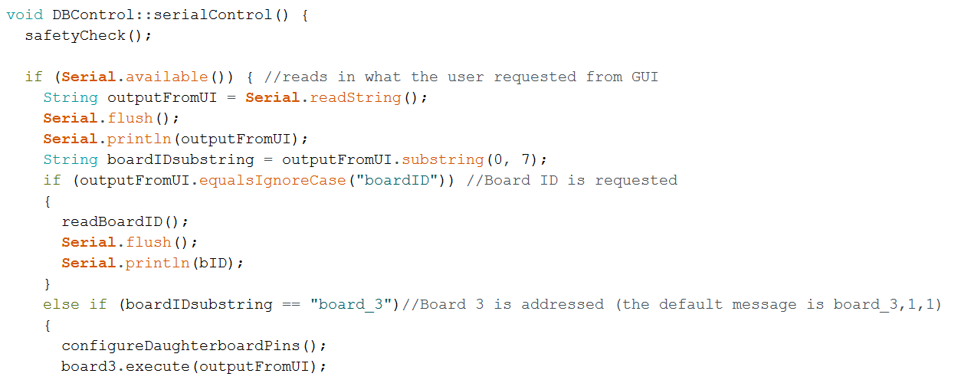
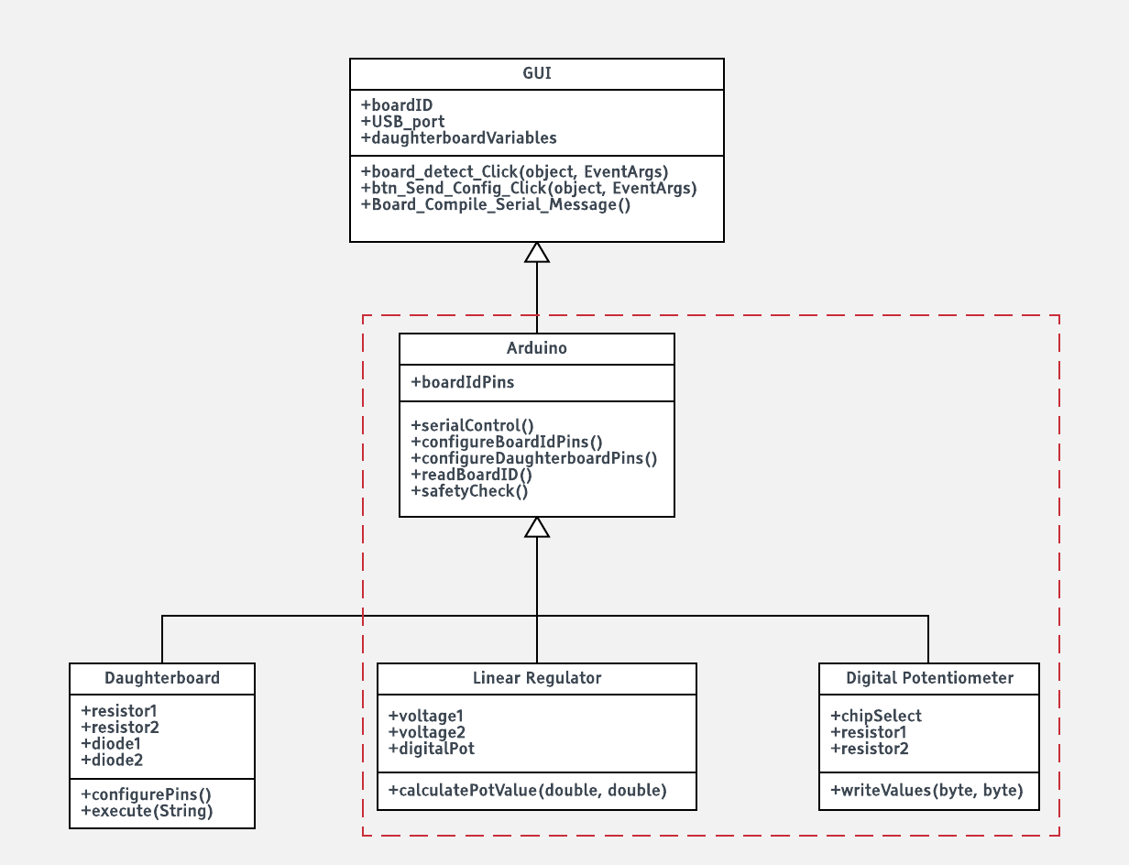
Arduino Software
Daughterboard Control
Daughterboard check
Configure and execute daughter board software
Linear Voltage Regulator Control
Linear regulator shut down
Manipulate two negative or two positive regulators
Daughterboard requests regulator voltages
Digital Potentiometer Control
1024 position, 20 kΩ potentiometer
Receives digital resistance value from linear regulators
SPI serial communication

Slide 17
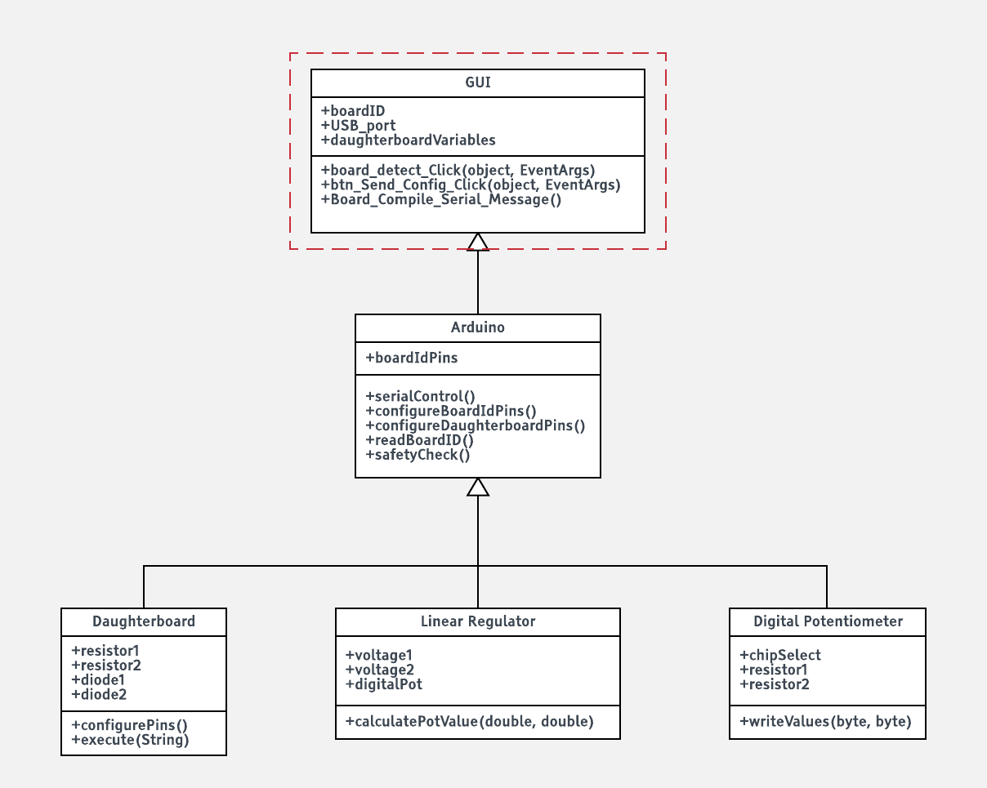
Graphical User Interface Software
Converted from Visual Basic to C#
Industrial language
Community support
Predetermined settings
GUI/Arduino interaction

Slide 18
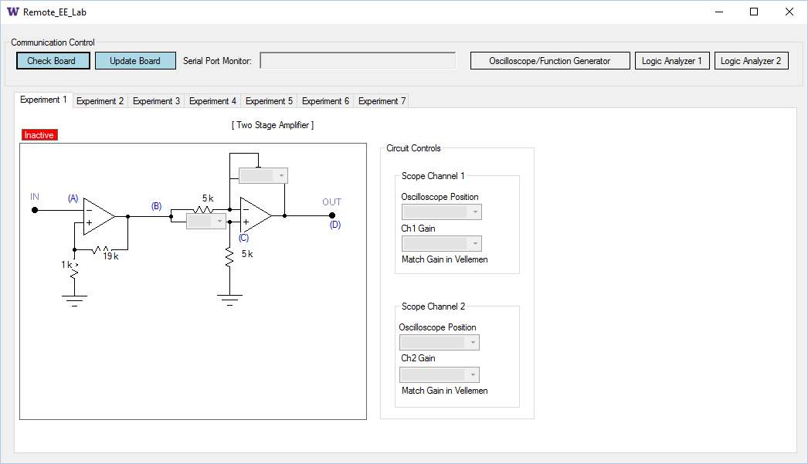
Initial GUI Screen
Elements
Buttons
Drop down menus
External Software
Logic analyzer software
Oscilloscope software

Slide 19
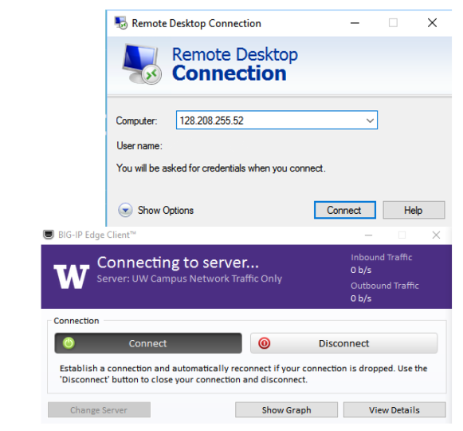
Accessing the RLS
On campus
VIA Husky OnNet VPN

Slide 20
Project Management

Slide 21
Project Management
First group meeting
Only one third of capstone teams finish in two quarters
Importance of a schedule

Slide 22
Research Phase
How we began
Bumps in the road
Roadblock
Notes:
The success of our project was not without it’s challenges. We began with a system that did not function, and had no supporting documentation. Our first several weeks of capstone was spent reaching out to the previous team for support and attempting to figure out the software to get the old system operational. We started to realize midway through the first quarter the system didn’t actually have software written to operate any of it’s components and we would have to start from scratch.
During one of our meetings with our faculty advisor, Dr. Berger helped us realize we didn’t need to fully understand what the previous team had designed as we could make any changes as long as the connector remained consistent. This was a turning point for the project. With this realization we were able to make swift progress in designing the new motherboard from scratch.
Around the end of the first week of August we came to a point where there was nothing left to do design wise. We still had to work on paperwork but the system was complete, operational, and passed all of our tests. This was a very satisfying point for everyone. The struggles we had in figuring out how to set resistance values for the linear regulators to work properly, determining how the previous system was meant to work, to finding out it never did. We did it.

Slide 23
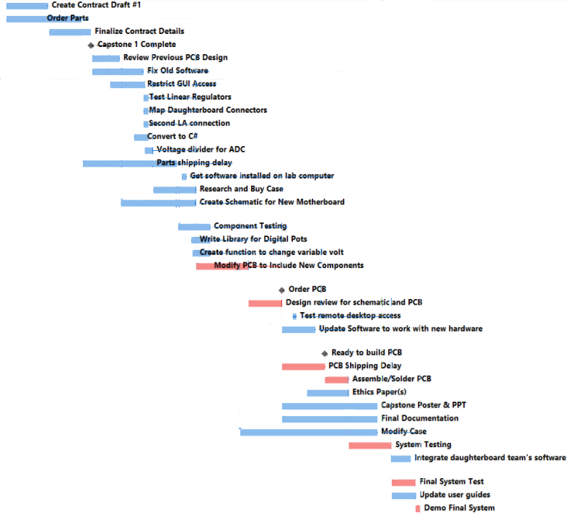
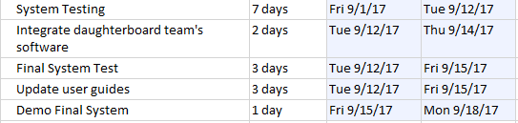
Project Management
Task determination
Schedule Creation
Notes:
At this point we determined we needed to make a schedule. But in order to make a schedule, we needed to figure out what actually needed to be done. So, one night after all of our classes had ended we went and found a room with many white boards. I handed everyone a marker and told everyone to pick a whiteboard and write down everything you can think of that you personally know needs to get done on this project. We worked independently on our lists for several minutes then came together and went through each task coming up with estimations on time to complete each task.
Using the collective list of tasks I then created a schedule using Microsoft Project. The creation of this schedule gave us an estimated completion date based on the process times of each task. With this distant date in mind we then began to lay out a work schedule for the team. I had the team treat this as if it were a job: if you’re running late or can’t make it for any reason call or text to inform everyone. We decided on working 4 days a week for a total of 24 hours per person per week. At the end of every week we reviewed our schedule and added/updated the tasks lists to keep up to date on our overall progress.

Slide 24
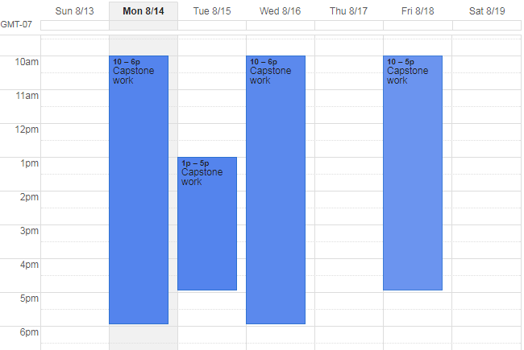
Project Management
Work schedule
Schedule tracking

Slide 25
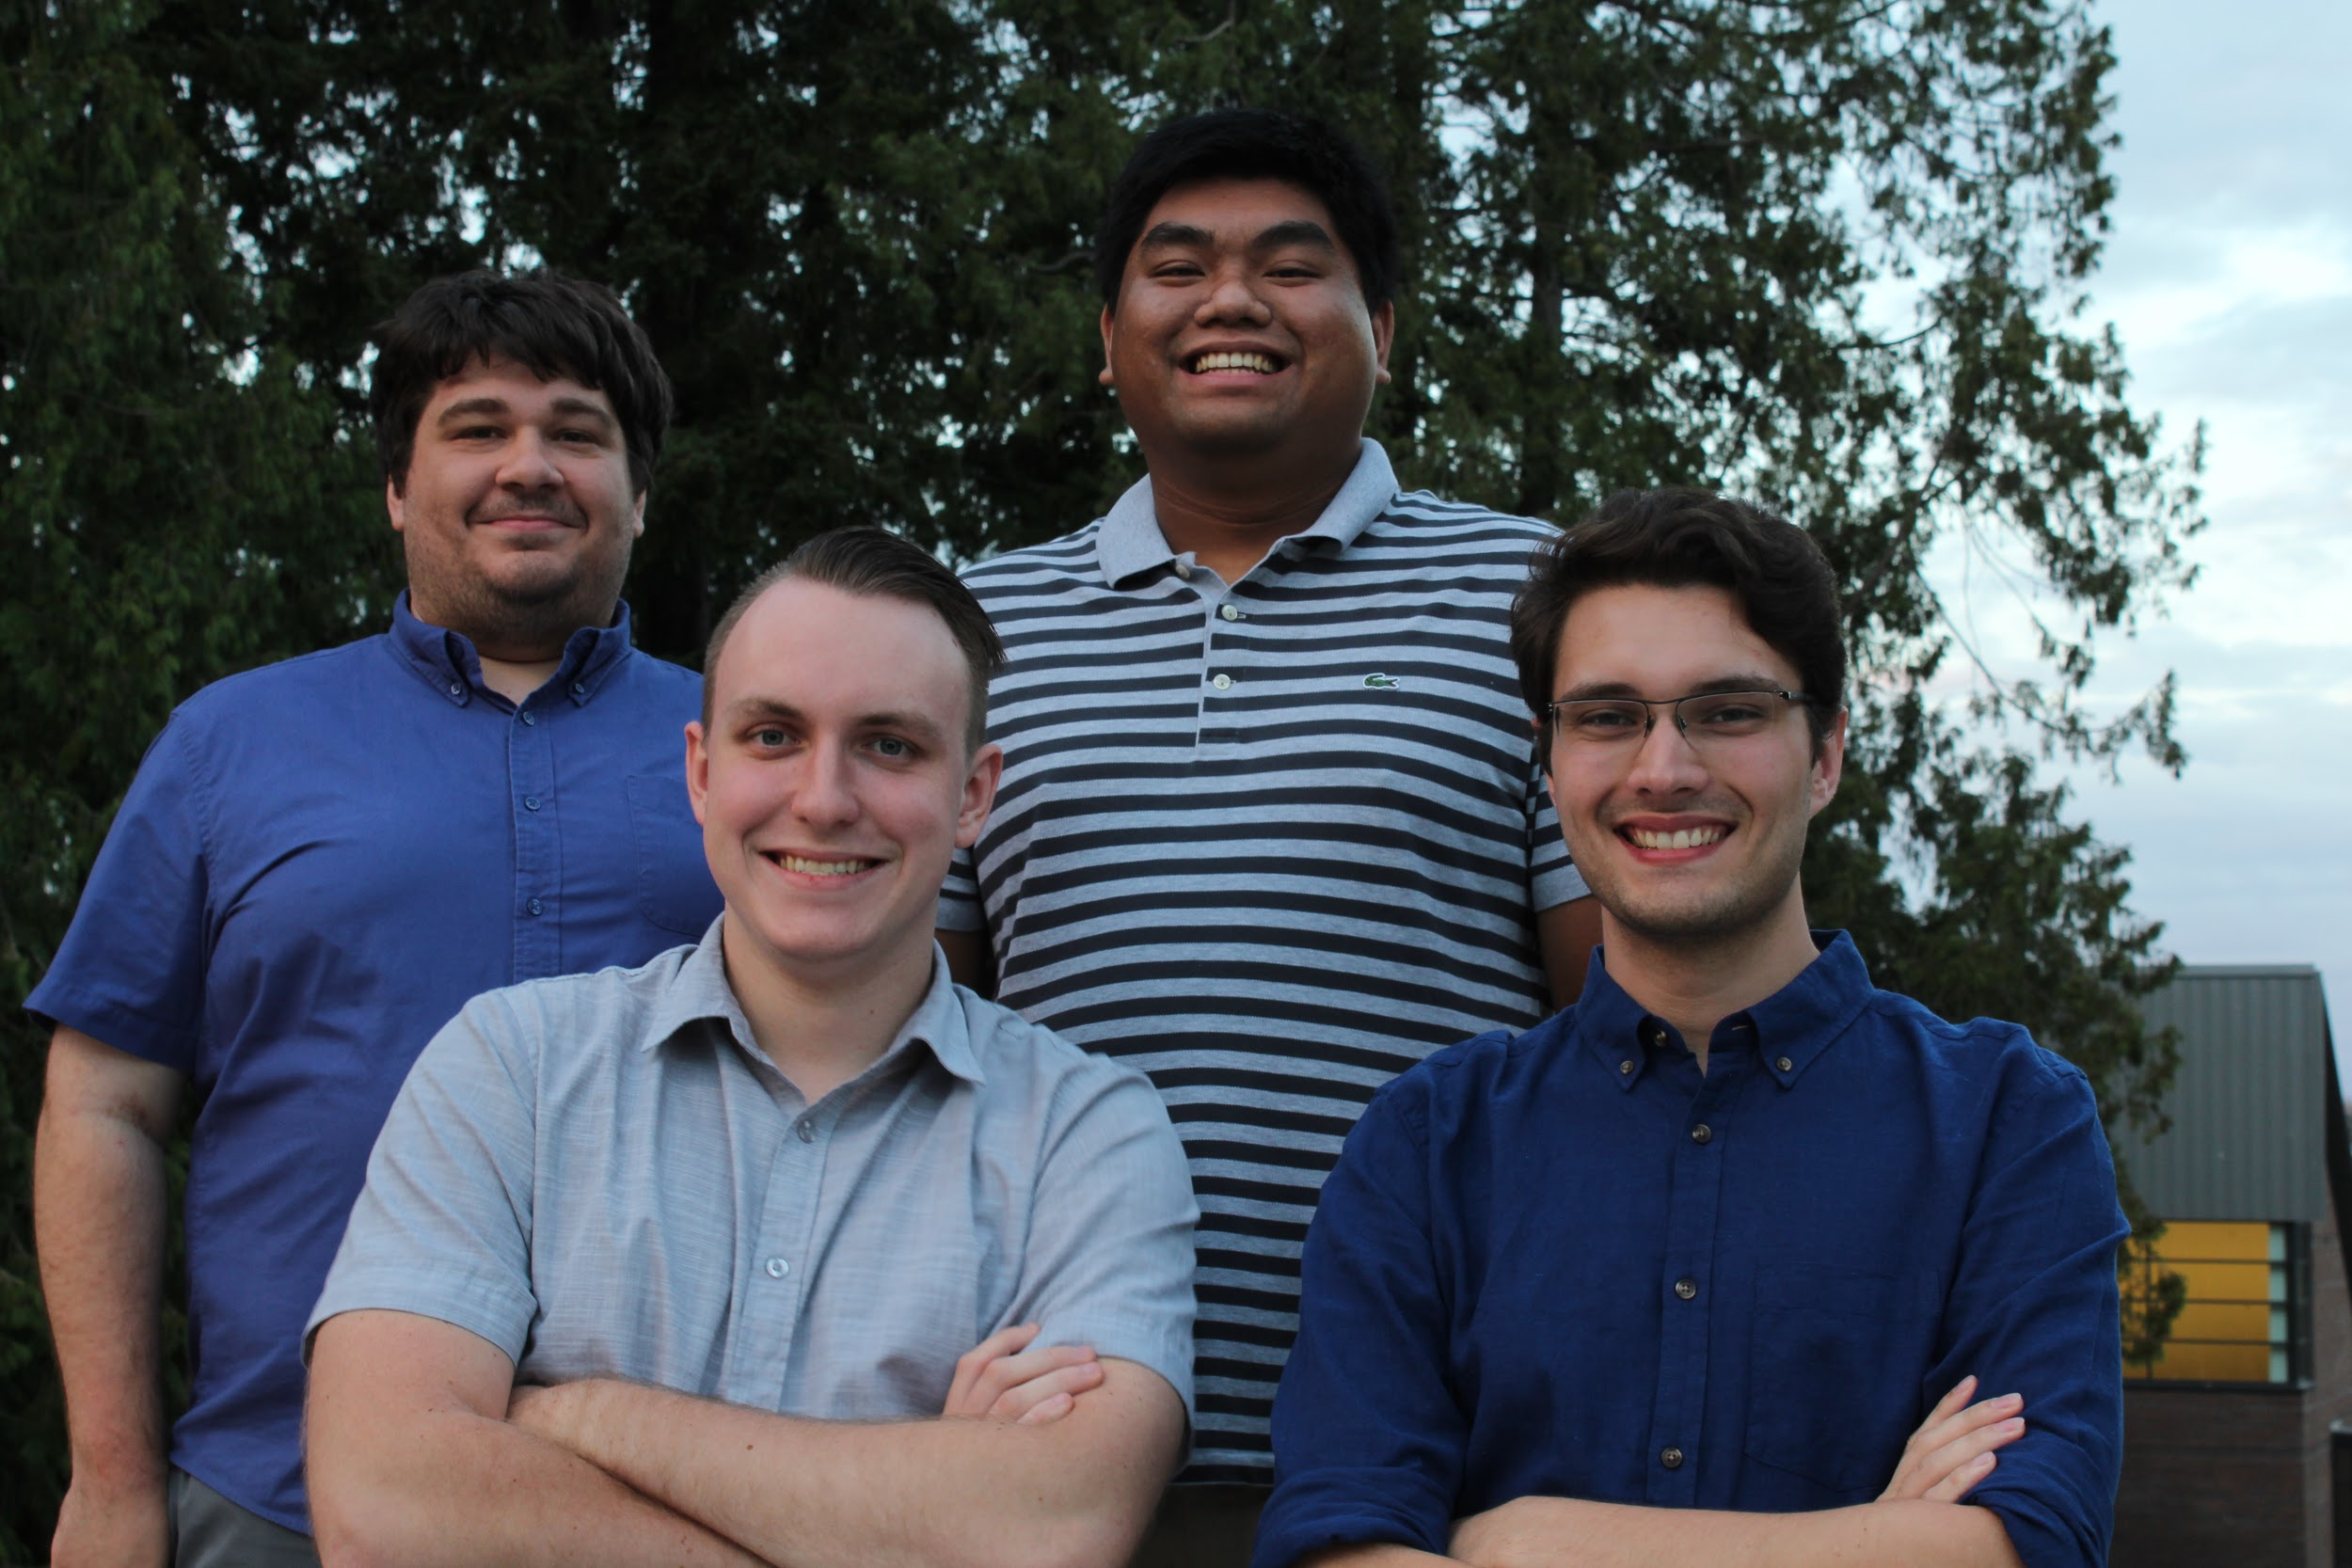
We did it!
Finished early
More time to work on documentation

Slide 26
Reflections
CSS 350: Management Principles
CSS 360: Software Engineering
CSS 427: Embedded Systems 1
BEE 425: Microprocessor System Design

Slide 27
Aknowledgements
Dr. Arnold Berger
Troy Dunmire
Chris Fox
Joe Decuir
Prototron Circuits
Our families

Slide 28
Questions?

